Slide 1
Validation and Error Handling
Ishaan Malik

Slide 2
Validation
Validation ensures that incoming request data meets your application's requirements before processing.
It helps protect your API from invalid data, security vulnerabilities, and unexpected runtime errors.

Slide 3
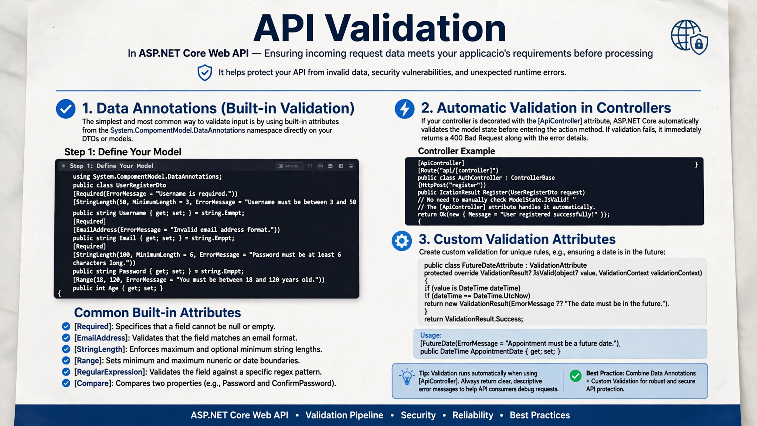

Slide 4
ProblemDetails
ProblemDetails is a standardized format used by web APIs to return error messages to clients.
Instead of every API creating its own style of error message (where one API calls it errorMessage, other calls it msg, and a third just returns text).
By default, when using the [ApiController] attribute, ASP.NET Core automatically formats automatic validation errors into a standard ValidationProblemDetails response (a subclass of ProblemDetails).

Slide 5
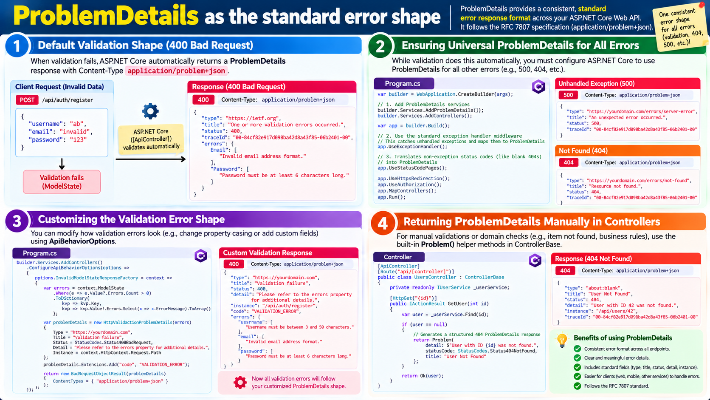

Slide 6
Global exception handling
Global exception handling means one central place catches every unhandled exception in your API and turns it into a clean, consistent error response.
Without any handling, an unhandled exception gives the client a bare 500 error, and in development a long stack-trace page. Putting try/catch in every action is repetitive and inconsistent.
There are two ways to build it: a custom middleware with try/catch, and IExceptionHandler.

Slide 7
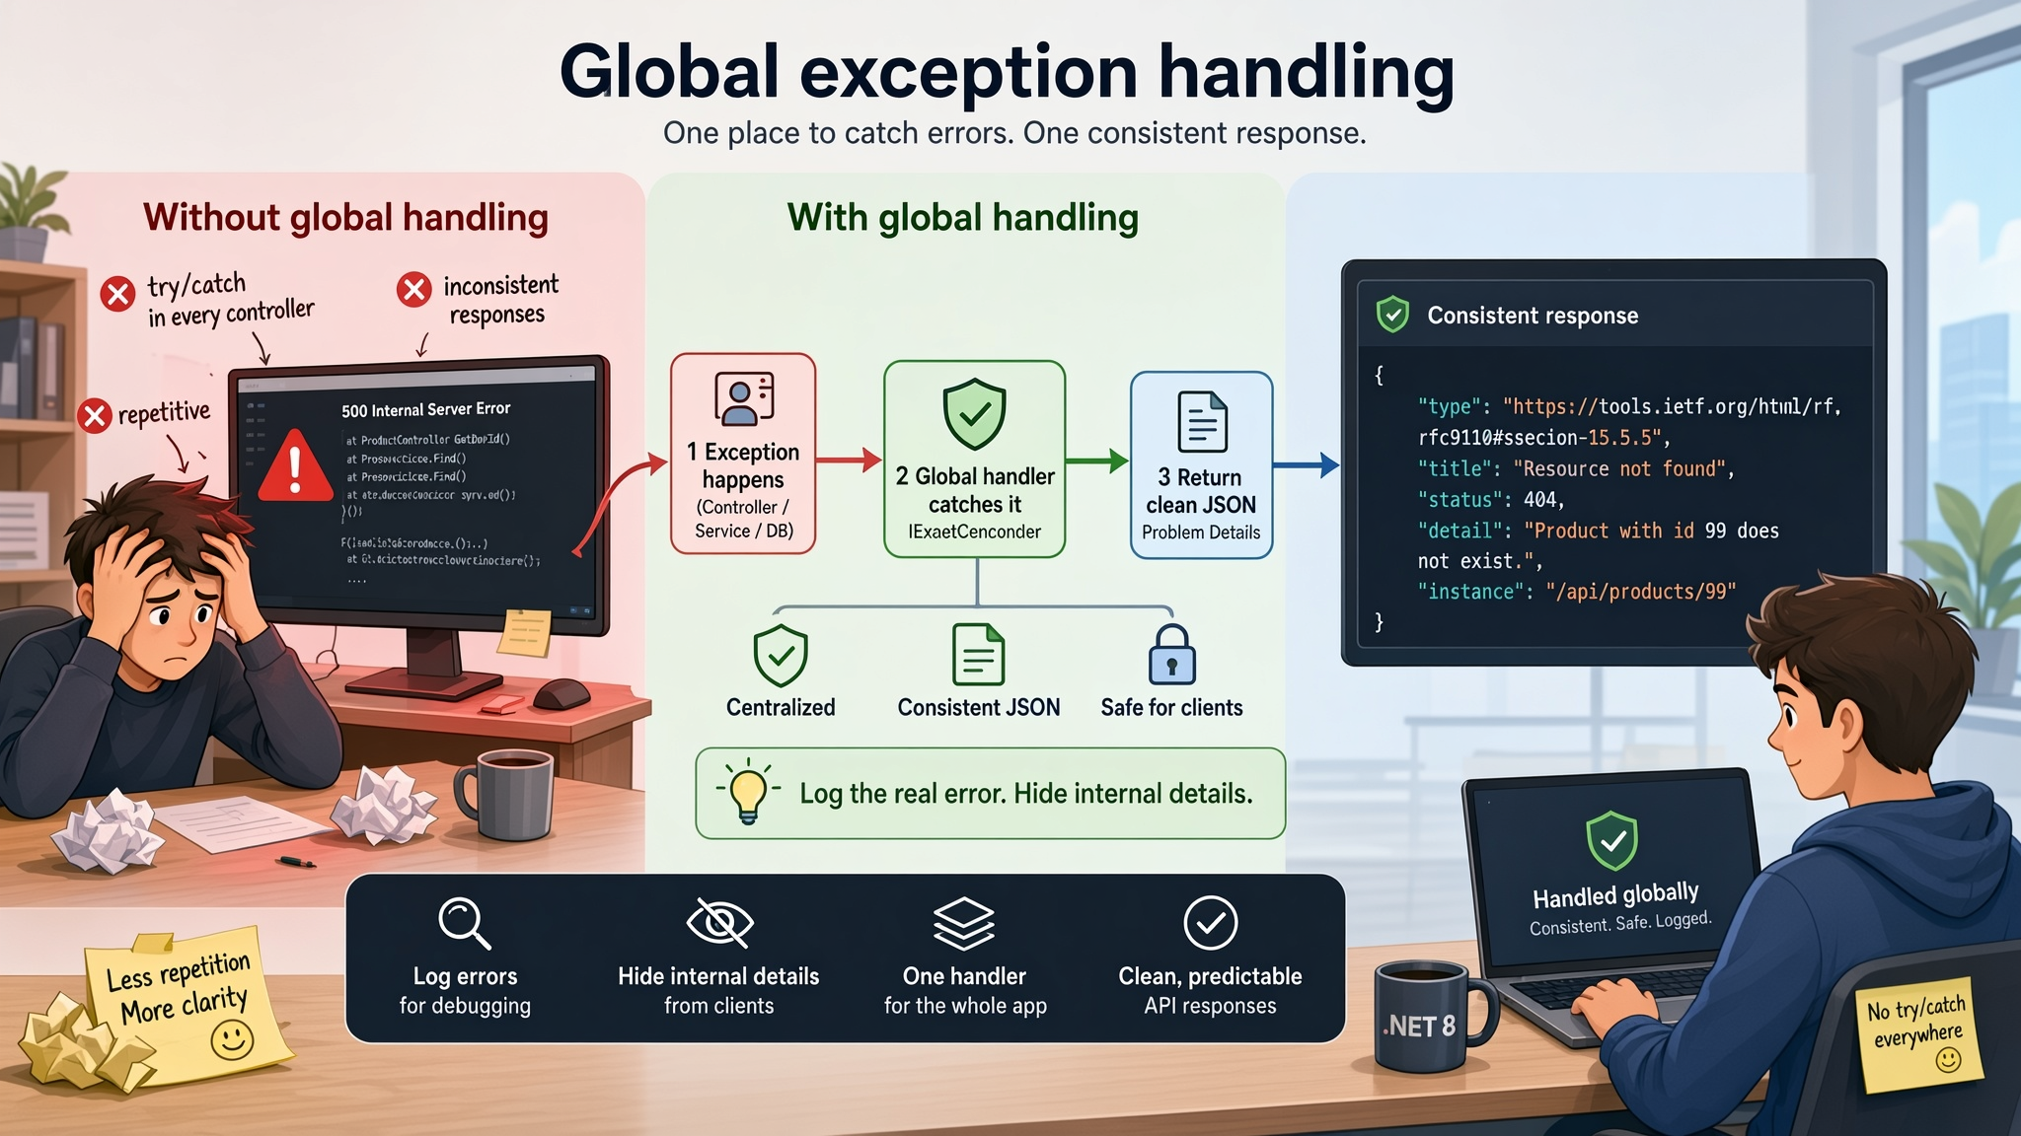

Slide 8


Slide 9
ILogger
ILogger is ASP.NET Core's built-in way to write log messages that record what your app is doing.
Each message has a level (how serious it is) and a message template with named placeholders (so the data stays structured).

Slide 10
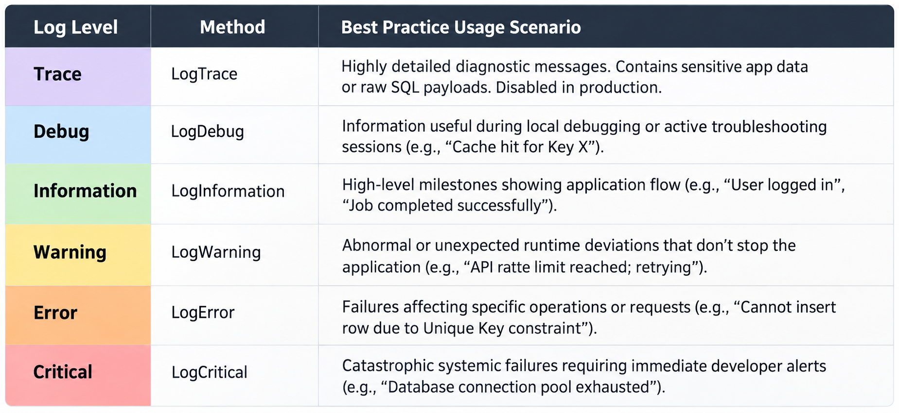
Understanding Logging Levels
EF Core and ASP.NET Core utilize six distinct log levels to categorize message severity.

Slide 11
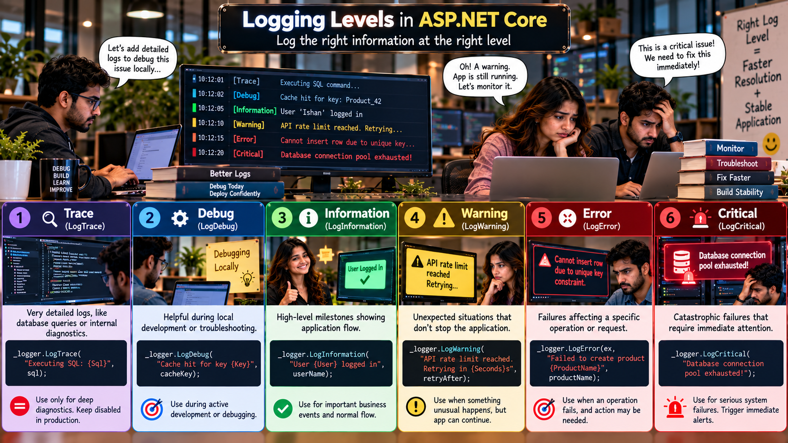

Slide 12


Slide 13
Quick Quiz
When a controller is decorated with the [ApiController] attribute and an incoming request fails model state validation (e.g., a required field is missing), what does ASP.NET Core do by default?
It throws an unhandled InvalidOperationException.
It continues executing the action method, forcing the developer to manually check ModelState.IsValid.
It automatically short-circuits the request and returns a 400 Bad Request response containing a ValidationProblemDetails payload.
It redirects the user to a generic error page.
Answer: C

Slide 14
Quick Quiz
In modern .NET applications (.NET 8 and later), what is the recommended interface to implement for intercepting, logging, and customizing unhandled exceptions globally instead of writing traditional custom middleware?
IMiddleware
IErrorFilter
IExceptionFilter
IExceptionHandler
Answer: D

Slide 15
Quick Quiz
Which built-in class should you instantiate if you want to manually return an industry-standard, machine-readable validation error response from a custom validation routine?
JsonResult
HttpValidationProblemDetails
BadObjectResult
ExceptionDetails
Answer: B

Slide 16
Q&A
The End

